Slide 2
RESEARCH INFRASTRUCTURES AS KEY COMPONENT
FOR THE DEVELOPMENT OF OPEN SCIENCE
A significant boost to the development of 'open science' comes from the creation and enhancement of Research Infrastructures (RIs). The practice of 'open science,' facilitated by RIs, is realized through activities enabling researchers or interested parties to access data, tools and services.
What are RIs? A simple definition could be:
“RIs are sociotechnical platforms crucial for conducting high-quality research,
often based on data of considerable size and complexity sourced from diverse origins”.
The objective of RIs extends beyond mere scientific data sharing, encompassing the provision of innovative tools and services for research, fostering initiatives to build communities, and engaging social and political actors (public engagement).

Slide 3
FOSSR OVERVIEW
Create an Italian Open Science Cloud, inspired by EOSC, to integrate innovative services for the collection, management, and analysis of economic and social data, promoting fairness (FAIRNESS).
MAIN OBJECTIVE
Establish a framework of tools and services for the social science academic community in Italy, integrating the Italian nodes of three RIs: CESSDA-ERIC, SHARE-ERIC, and RISIS.
FRAMEWORK
Develop an integrated platform for knowledge sharing and access to tools and services providing a centralized resource for researchers.
INTEGRATED
PLATFORM
Promote knowledge and awareness of social science data and methods, harmonizing data from Italian archives
Support methodological advancements in data collection and analysis
Make advanced panels for longitudinal analyses available
Offer scientific training programs based on FAIR empirical data
KEY
CONTRIBUTIONS
Missione 4 • Istruzione e Ricerca

Slide 4
AIM OF THE PROJECT
Creation of an Italian Open Science Cloud for the Social Sciences
which shall provide innovative tools and services to investigate issues related to the economic and societal change of contemporary societies
Structure of economy
Demography
and society
innovative firms and fast-growing firms, innovation processes and outcome, new modes of knowledge production
ageing, wealth distribution,
inequalities, education,
migration, etc.
Public policies
Social behaviors
Design, implementation and assessment of e.g., R&I policies, health policies, human resources policies
Models for social simulation
These are key topics addressed by the National Recovery and Resilience Plan (PNRR).
Network of Research Infrastructures (RIs) with open resources of high-quality FAIR data (Findable, Accessible, Interoperable, and Reusable), information, services, indicators, are key resources to improve the evidence-based decision-making capabilities in different policy domains.
Missione 4 • Istruzione e Ricerca

Slide 5
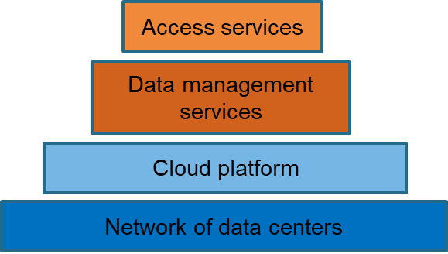
Cloud Infrastructure Architecture
SINGLE POINT OF ACCESS (FEDERATED AUTHENTICATION)
CONSORTIUM OF EUROPEAN SOCIAL SCIENCE DATA ARCHIVES

Slide 6
THE THREE RESEARCH INFRASTRUCTURES INTEGRATED IN THE FOSSR PROJECT
CESSDA ERIC Consortium of European Social Science Data Archives European Research Infrastructure Consortium, of which Italy joined in July 2021, which provides the scientific community with facilities, tools, datasets, and certified services to conduct research activities of excellence in the social sciences domain.
SHARE ERIC Survey of Health, Aging and Retirement in Europe European Research Infrastructure Consortium, an interdisciplinary and longitudinal survey on the economic, social, health and well-being conditions of the 50+ population in twenty-eight European countries (plus Israel).
RISIS Research Infrastructure for Research and Innovation (R&I) Policy Studies provides data and services to support the development of a new generation of analyzes and indicators for the study of Science, Technology and Innovation processes on the base of three main perspective: actors involved, topics addressed to understand the directionality of the R&I efforts, and geography of science and innovation.

Slide 7
CESSDA-ERIC: CONSORTIUM OF EUROPEAN SOCIAL SCIENCE DATA ARCHIVES
The CESSDA Data Catalogue hosts over 40,000 data collections from CESSDA's Service Providers, representing more than 20 European countries. It serves as a gateway for accessing and discovering European social science data.
Many datasets are available encompassing a variety of types: quantitative, qualitative, or mixed-modes, spanning cross-sectional or longitudinal studies, and ranging from recent to historical data.
DASSI, managed by UniBicocca and CNR, functions as the Italian service provider for CESSDA-ERIC, providing:
data, tools, and services catering to social science research needs
a platform for both depositing and utilizing research data for new studies.
It also supports a long-term data preservation and sharing, promoting for data accessibility and reuse.

Slide 8
SHARE-ERIC- SURVEY OF HEALTH, AGEING AND RETIREMENT IN EUROPE
SHARE is a resource for studying the effects of health, social, economic and environmental policies over the life-course of European citizens and beyond. SHARE data collection is based waves of computer-assisted personal interviews (CAPI). Due to the outbreak of the COVID-19 in March 2020 all face-to-face interviews needed to be stopped and a telephone survey was conducted.
The SHARE interview comprises different thematic blocks or modules, covering topics such as employment and pensions, household income, and financial transfers.
In each participating country, a country team manages the national or regional data collection and ensure the same methodological standards in all SHARE countries.

Slide 9
RISIS – RESEARCH INFRASTRUCTURE ON SCIENCE AND INNOVATION POLICY STUDIES
RISIS focuses on services and data for science and innovation policy studies. It is developed by 18 partners including universities and research centers in Europe.
4 datasets inside the Italian node:
EFIL – on public R&D funding instruments aims at enabling users to investigate public R&D funding in Europe at the level of project funding instruments and Research Funding Organizations (RFO).
VICO – on geographical, industry and accounting information on start-ups that received at least one venture capital investment in the period 1998-2014. Start-ups have been incorporated from 1988 onwards in 7 European countries (Belgium, Finland, France, Germany, Italy, Spain, UK) and Israel.
CHEETAH on geographical, industry and accounting information on mid-sized firms that experienced fast growth during the periods 2008-2011, 2009-2012 and 2010-2013. It includes 42,369 mid-sized firms located in 30 European countries and Israel.
JOREP 2.0 on European trans-national joint R&D programmes and a basic set of descriptors of agencies participating to the programmes. The current version 2.0 covers data for the period 2000-2014.

Slide 10
FOSSR added value
The importance of creating linkages and synergies between RIs dealing with social sciences is not new.
The most relevant experiences of creating integration between different European RIs can be related to the initiatives:
Social Sciences & Humanities Open Cloud (SSHOC) Project;
Synergies for Europe’s Research Infrastructures in the Social Sciences (SERISS);
European Open Science Cloud Initiative (EOSC).
The additional value of FOSSR mainly rests in the creation of a network of the RIs in social sciences that
develops new open services and resources, highly innovative not yet existing in Italy and essential for robust analysis and research investigations in social sciences
builds an Open Cloud linked to a network of data centers mainly located in the South of Italy, which are supposed to improve the computing facilities existing at local level

Slide 11
Expected outcomes
Facilitating and promoting the remote access to high quality data for the social sciences by using the Italian Open Science Cloud
Training new generations of researchers / data users and disseminate the results deriving from projects developed by using the resources provided
06
Promoting the use of data for the social sciences among scholars and non-academic users and assist data users to exploit data and resources
Building a distributed set of data centers that help to storage and distribute data and resources derived from the combined activities of the thematic network
01
02
05
04
Strengthening the ability of decision makers to interpret data and use them for policy design (ex-ante evaluation of the different options) and for ex post evaluation of policies and their impact
Providing innovative tools to collect, explore, analyze, and harmonize data
03
Developing a governance model that can support the long-term activity of the thematic network beyond the end of the project

Slide 12
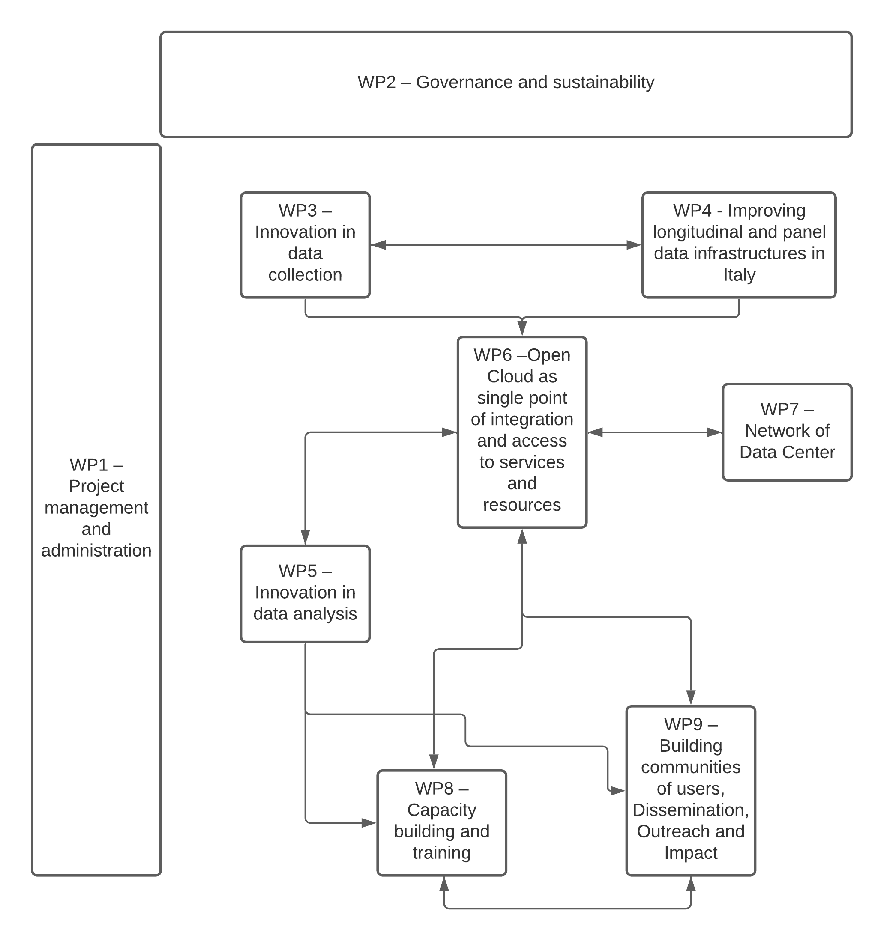
Work Package leader
WP | WP leader name | Organization
WP1 | Daniela De Gregorio | CNR-ISMED - Istituto di studi sul Mediterraneo
WP2 | Massimiliano Saccone | CNR-DSU - Dipartimento Scienze Umane e Sociali, Patrimonio Culturale
WP3 | Antonio Zinilli | CNR-IRCRES - Istituto di Ricerca sulla Crescita Economica Sostenibile, sede di Roma
WP4 | Loredana Cerbara | CNR-IRPPS Istituto di Ricerche sulla Popolazione e le Politiche Sociali, sede di Roma
WP5 | Andrea Giovanni Nuzzolese | CNR-ISTC - Istituto di Scienze e Tecnologie della Cognizione, STLab
WP6 | Mario Ciampi | CNR-ICAR - Istituto di Calcolo e Reti ad Alte Prestazioni
WP7 | Mario Sicuranza | CNR-ICAR - Istituto di Calcolo e Reti ad Alte Prestazioni
WP8 | Andrea Orazio Spinello | CNR-IRCRES - Istituto di Ricerca sulla Crescita Economica Sostenibile, sede di Roma
WP9 | Alessandra Maria Stilo | CNR-IRCRES - Istituto di Ricerca sulla Crescita Economica Sostenibile, sede di Roma

Slide 13
FOSSR Organizational Structure
Secretariat - WP1 Project management – WP2 Governance and sustainability
The figure shows the FOSSR Management Structure with the identification of the 4 levels:
Decision/Strategic Level with Governing Board (GB),
Advisory Level with Scientific Coordinator (SC), Scientific Advisory Board (SB), FOSSR Ethics Committee (FOSSR-EC), Strategic Management Committee (SMC) and Stakeholders Advisory Board (SAB);
Executive Level: with the Executive Committee (ExCO), Infrastructure Manager (IM) and Administrative Responsible (AR);
Operational Level with, in a staff/transversal position, Management Support Team (Secretary), WP1 Project Management and administration, WP2 Governance and Sustainability, WP8 Capacity building and training and WP9 Building Communities of users, Dissemination, Outreach and Impact and in a more operational position of WP3 Innovation on collection, WP4 Improving longitudinal and panel data infrastructures in Italy, WP5 Innovation in data analysis, WP6 Open Cloud as single point of integration and access to services and resources, WP7 Network or Data Centre.
ADVISORY LEVEL
STRATEGIC LEVEL
OPERATIONAL LEVEL
WP3
Innovation in data collection
Governing Board (GB)
Strategic Management Committee (SMC)
Scientific Advisory Board (SB)
WP4
Improving longitudinal and panel data infrastructures in Italy
Ethical Committee (EC)
Scientific Coordinator
Infrastructure Manager
WP5
Innovation in data analysis: knowledge extraction, integration and enrichment
Stakeholders Advisory Board (SAB)
EXECUTIVE LEVEL
WP6
Open Cloud as single point of integration and access to services and resources
Executive Committee (ExCo)
Administrative Responsible
WP7
Network od Data Centre
WP8 Training and capacity building – WP9 Communication dissemination and outreach

Slide 14
Scholars SS field
FOSSR Ethics
Committee
Strategic
Management Committee
WP2
Governance and Sustainability
MUR
Potential Users
Users
Data Scientists
Scientific
Advisory
Board
FOSSR Partners
Governing
Board
Scientific
Coordinator
Doctoral holders
WP1
Project Management
Executive
Committee
Management Support Team (Secretariat)
Administrative Responsible
WP6
Open Cloud as single point of integration and access to services and resources
WP3
Innovation in data collection
Infrastructure
Manager
Other Research Infrastructures
WP4
Improving longitudinal and panel data infrastructures in Italy
Stakeholders
Advisory
Board
WP7
Network of Data Centre
Statistical officers
WP5
Innovation in data analysis: knowledge extraction, integration and enrichment
Stakeholders
WP8
Capacity building and training
NGOs
EU officers
Local politics
??
??
Potential Users
WP9
Communication, Dissemination and Outreach
??
Public managers
Investors
Policymakers
Foundations

Slide 15
FOSSR INNOVATIVE TOOLS
An important target of the Project FOSSR involves creating tools and services dedicated to data collection and analysis.
FOSSR will provide resources to support methodological advances in data collection and analysis, address new research questions, and improve the robustness of results.
It will also provide tools and services for building online probability and research panels for longitudinal surveys and establish an online laboratory network (VREs).
The project also includes training initiatives to develop the skills of researchers and foster interactions between knowledge producers and stakeholders through higher education courses, with a focus on empowering young researchers.

Slide 16
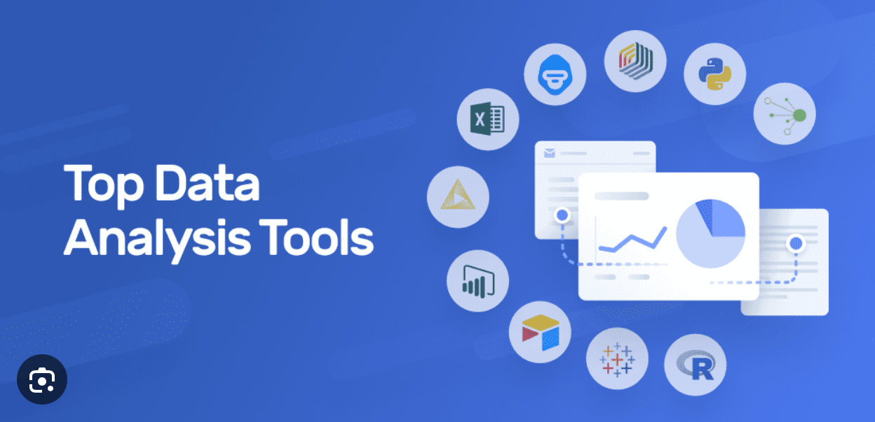
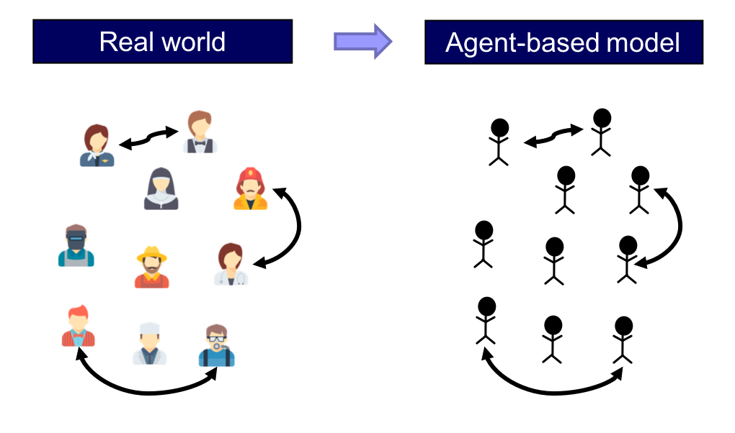
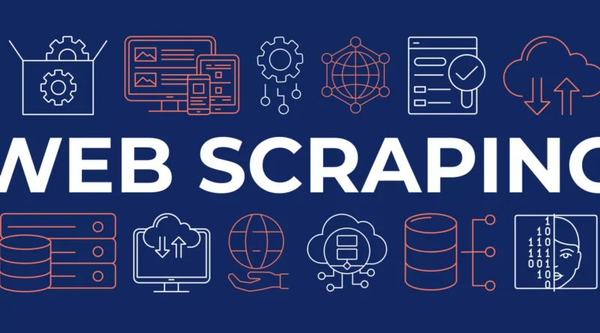
Fase
di
analisi
Fase
di
sviluppo
Analytics and descriptive stats
Online longitudinal panels
Policy Learning Platform
Fase
di
analisi
Fase
di
sviluppo
Fase
di
analisi
Fase
di
sviluppo
Forecaster
Fase
di
analisi
Fase
di
sviluppo
Italian Online Probability Panel
Go live
Fase
di test
Fase
di test
Go live
Fase
di test
Go live
Go live
Fase
di test
Online Research Panel
User Based Data Extraction
Fase
di
analisi
Fase
di
sviluppo
OPEN CLOUD
Go live
Fase
di test
Support and Advise
Fase
di
analisi
Fase
di
sviluppo
Survey-generator of new data
Survey-maker
Fase
di
analisi
Fase
di
sviluppo
FOR USERS
Go live
Fase
di test
Go live
Fase
di test
TOOLS
&
Fase
di
analisi
Fase
di
sviluppo
TOOLS
&
Go live
Fase
di test
SERVICES
Open Documentation
Dissemination External Repository
SERVICES
Fase
di
analisi
Fase
di
sviluppo
Data curation and preservation
High Performance Computing
(HPC)
Query and data extraction
Go live
Fase
di test
Virtual Research Environment
(VRE)
ABM Laboratory
(agent-based model)
Training and Public
Engagement
Web-scraping
Fase
di
analisi
Fase
di
sviluppo
Fase
di
analisi
Fase
di
sviluppo
Go live
Fase
di test
Fase
di
analisi
Fase
di
sviluppo
Fase
di
analisi
Fase
di
sviluppo
Fase
di
analisi
Go live
Fase
di test
Fase
di
sviluppo
Go live
Fase
di test
Go live
Fase
di test
Go live
Fase
di test

Slide 17
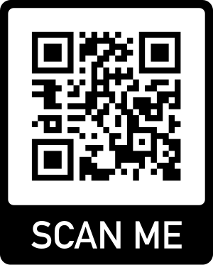
THANK YOU!

